Slide 1
Process and Thread 2
07/08/2021

Slide 2
Terms
Process: a single thread called a main thread (light weight process)
Can create multiple threads using PT_threadcreate or can use fork/exec to create many processes
Group of Processes → Thread
Thread: a process that shares text/data segment with parents & every other thread
Has its own stack
Heap is SHARED with all other processes
Group of Threads → Process

Slide 3
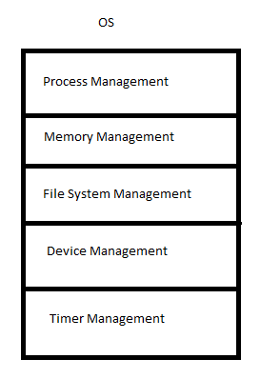
Entities & Actions
Process Management deals with entities (which are processes and threads) which perform actions (which are mutual exclusion, synchronization, and communications)

Slide 4
Shell
Shell takes commands and searches for the program in your PATH
If found:
The loader (SW) copies the program from disk into dRAM (remember → register, cache orsRam, RAM or dRam, disk or C: ) wherever Dram has empty space
PC points to starting address of the program
CPU runs the program (5 stages, fetch, decode, execute + mem)

Slide 5
Process State Diagram
What is a process?
A running instance of an executable program with its own text, data, stack, heap/shared heap
When a process is created, memory as well as a PID is allocated for all segments
Goes to Ready to Run
Within the OS, a scheduler decides who runs next in the queue (first come first)
CPU is allocated to the process and the PC now points to the first line → running state
Blocking Call:
CPU bound instructions (rely on 5 stages)
I/O bound instruction
Context Switching: when the initial program goes into a blocked state the wait for the answer from whichever peripheral is helping the CPU, so the scheduler runs the next in line in the ready to run queue
Peripheral is ready ? It interrupts the CPU
Preemption → The current running is not I/O potentially, so it cannot be blocked, instead pgm1 starts running again and pgm2 is put back into ready to run queue
Exit Call → Goes to zombie state and all resources are released

Slide 6
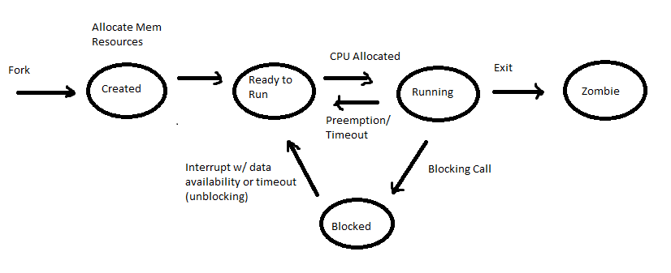

Slide 7
Process states in CMD
Call to know which process state we’re in : /proc <directory>
For every running process, /proc has a directory (name is a PID) with many files
Specific file: Stack Trace (How much stack, memory)
Process Termination
Kill API on a PID
If parent process terminates, children are orphans
Parent is now init process

